Slide 2
Presentation technique
Emmanuel Deletang
Senior solutions architecte
Emmanuel.deletang@mongodb.com

Slide 3
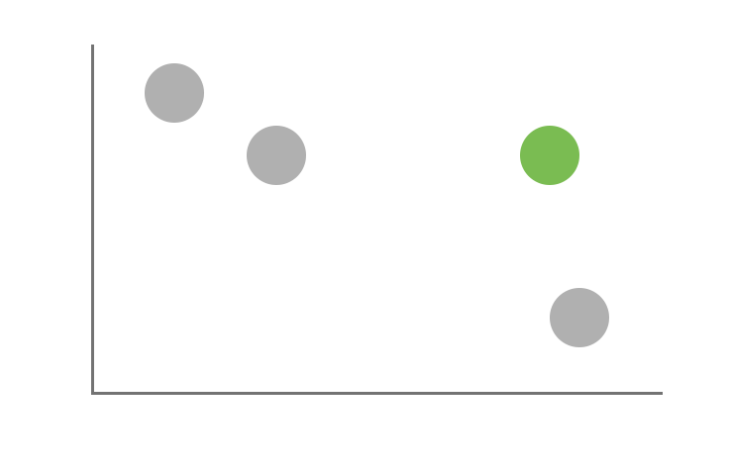
Operational Database Landscape
Key / Value
Wide Column
MongoDB
Scalability and Performance
RDBMS
Depth of Functionality

Slide 4
Relational
Expressive Query Language
& Secondary Indexes
Strong Consistency
Enterprise Management
& Integrations

Slide 5
The World Has Changed
Data Risk
Time Cost

Slide 6
NoSQL
Expressive Query Language
& Secondary Indexes
Flexibility
Strong Consistency
Scalability
& Performance
Enterprise Management
& Integrations
Always On,
Global Deployments

Slide 7
Nexus Architecture
Expressive Query Language
& Secondary Indexes
Flexibility
Strong Consistency
Scalability
& Performance
Enterprise Management
& Integrations
Always On,
Global Deployments

Slide 8
MongoDB Technical Capabilities
Application
Dynamic Document Schema
2. Native language drivers
db.customer.insert({…})
db.customer.find({
name: ”John Smith”})
{ name: “John Smith”,
date: “2013-08-01”),
address: “10 3rd St.”,
phone: [
{ home: 1234567890},
{ mobile: 1234568138} ]
}
Driver
Query Router
3. High availability
Replica sets
Shard 1
Shard 2
Shard N
4. High performance
Data locality
Rich Indexes
RAM
Primary
Primary
Primary
…
Secondary
Secondary
Secondary
Secondary
Secondary
Secondary
5. Horizontal scalability
Sharding

Slide 9
MongoDB 3.2 – a BIG Release
Document Validation
Fast Failover
Simpler Scalability
Aggregation ++
$lookup
Encryption At Rest
In-Memory Storage Engine
BI Connector
MongoDB Compass
APM Integration
Profiler Visualization
Auto Index Builds Backups to File System
Community
Doc-Level Concurrency
Compression
Storage Engine API
≤50 replicas
Auditing ++
Ops Manager
$out
Index Intersection
Text Search
Field-Level Redaction
LDAP & x509
Auditing
Enterprise
Hash-Based Sharding
Roles
Kerberos
On-Prem Monitoring
Agg. Framework
Location-Aware Sharding
2.2
2.4
2.6
3.0
3.2

Slide 10
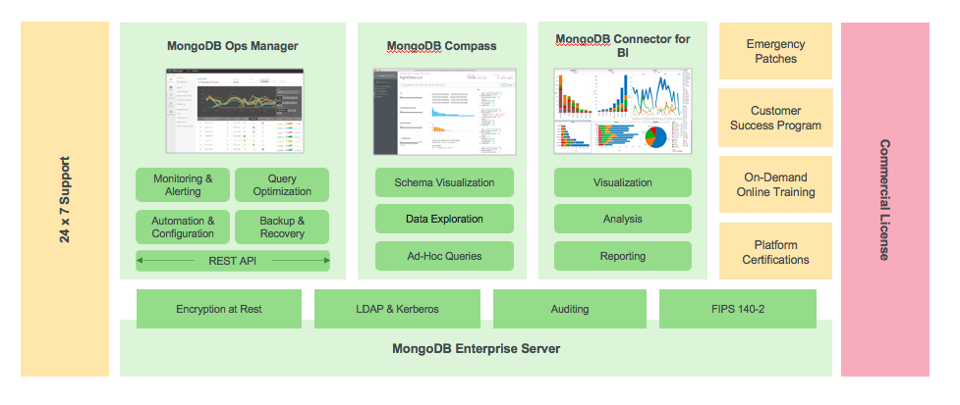
MongoDB Enterprise Advanced
Notes:
Green – Software
Yellow – Support + Programs to ensure your success
Red – Commercial license to protect your investment

Slide 11
Flexible Data Model

Slide 12
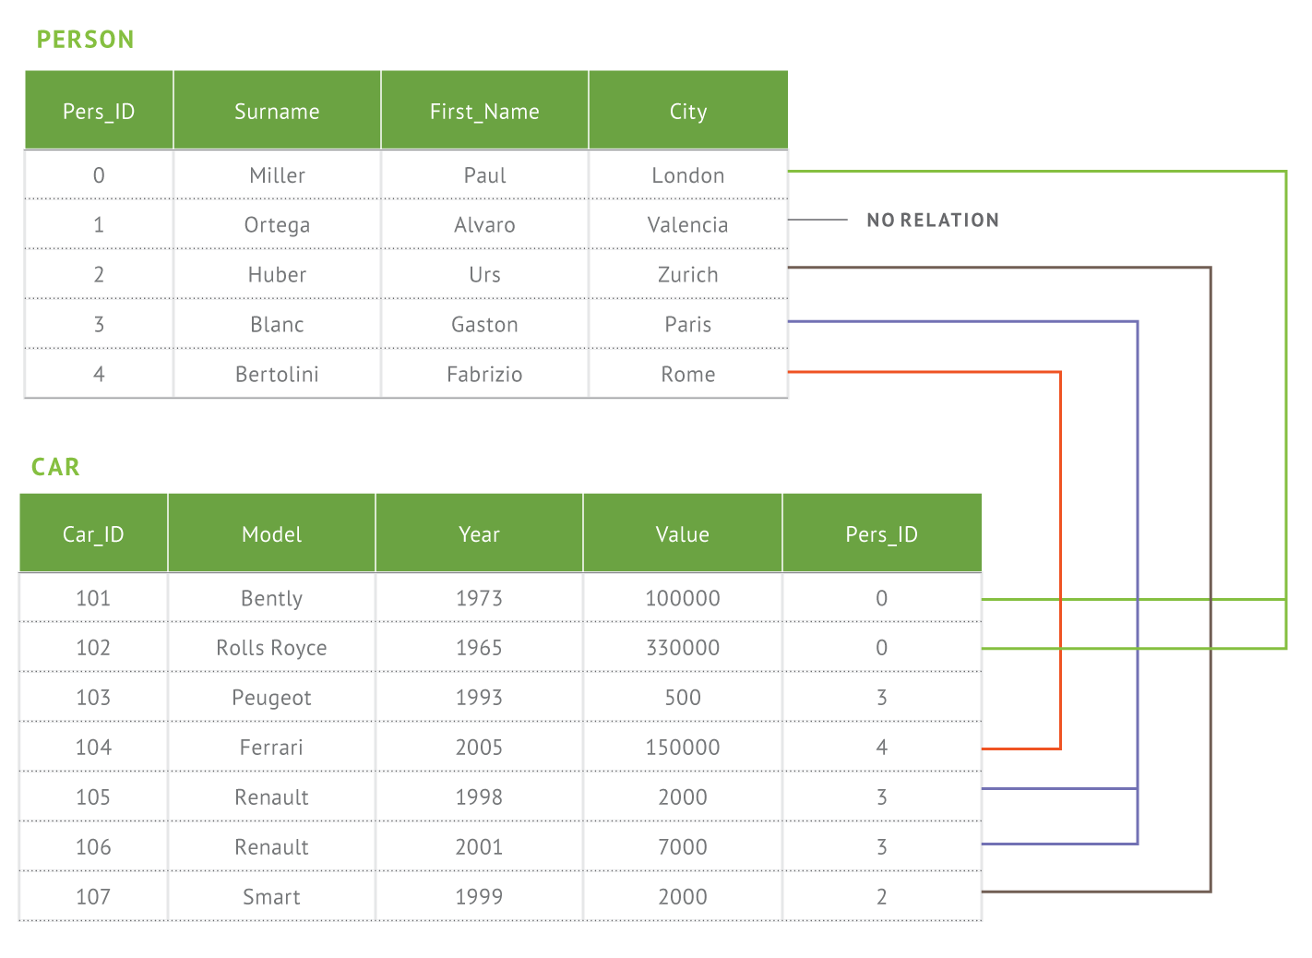
Document Model with Flexible Schema
RDBMS
MongoDB
{
first_name: ‘Paul’,
surname: ‘Miller’,
city: ‘London’,
location: [45.123,47.232],
cars: [
{ model: ‘Bentley’,
year: 1973,
value: 100000, … },
{ model: ‘Rolls Royce’,
year: 1965,
value: 330000, … }
]
}
Notes:
Here we have greatly reduced the relational data model for this application to two tables. In reality no database has two tables. It is much more common to have hundreds or thousands of tables. And as a developer where do you begin when you have a complex data model?? If you’re building an app you’re really thinking about just a hand full of common things, like products, and these can be represented in a document much more easily that a complex relational model where the data is broken up in a way that doesn’t really reflect the way you think about the data or write an application.
Document Model Benefits
Agility and flexibility
Data model supports business change
Rapidly iterate to meet new requirements
Intuitive, natural data representation
Eliminates ORM layer
Developers are more productive
Reduces the need for joins, disk seeks
Programming is more simple
Performance delivered at scale

Slide 13
Documents are Rich Data Structures
{
first_name: ‘Paul’,
surname: ‘Miller’,
cell: 447557505611,
city: ‘London’,
location: [45.123,47.232],
Profession: [‘banking’, ‘finance’, ‘trader’],
cars: [
{ model: ‘Bentley’,
year: 1973,
value: 100000, … },
{ model: ‘Rolls Royce’,
year: 1965,
value: 330000, … }
]
}
String
Number
Typed field values
Geo-Location
Fields can contain arrays
Fields
Fields can contain an array
of sub-documents

Slide 14
Geospatial query operators sample
Name | Description
$geoWithin | Selects geometries within a bounding GeoJSON geometry. The 2dsphere and 2dindexes support $geoWithin.
$geoIntersects | Selects geometries that intersect with a GeoJSON geometry. The 2dsphere index supports $geoIntersects.
$near | Returns geospatial objects in proximity to a point. Requires a geospatial index. The2dsphere and 2d indexes support $near.
$nearSphere | Returns geospatial objects in proximity to a point on a sphere. Requires a geospatial index. The 2dsphere and 2d indexes support $nearSphere.

Slide 15















Drivers & Frameworks
Java
Ruby
Python
Perl
MEAN Stack
Morphia
Notes:
Support for the most popular languages and frameworks

Slide 16
Data Governance

Slide 17
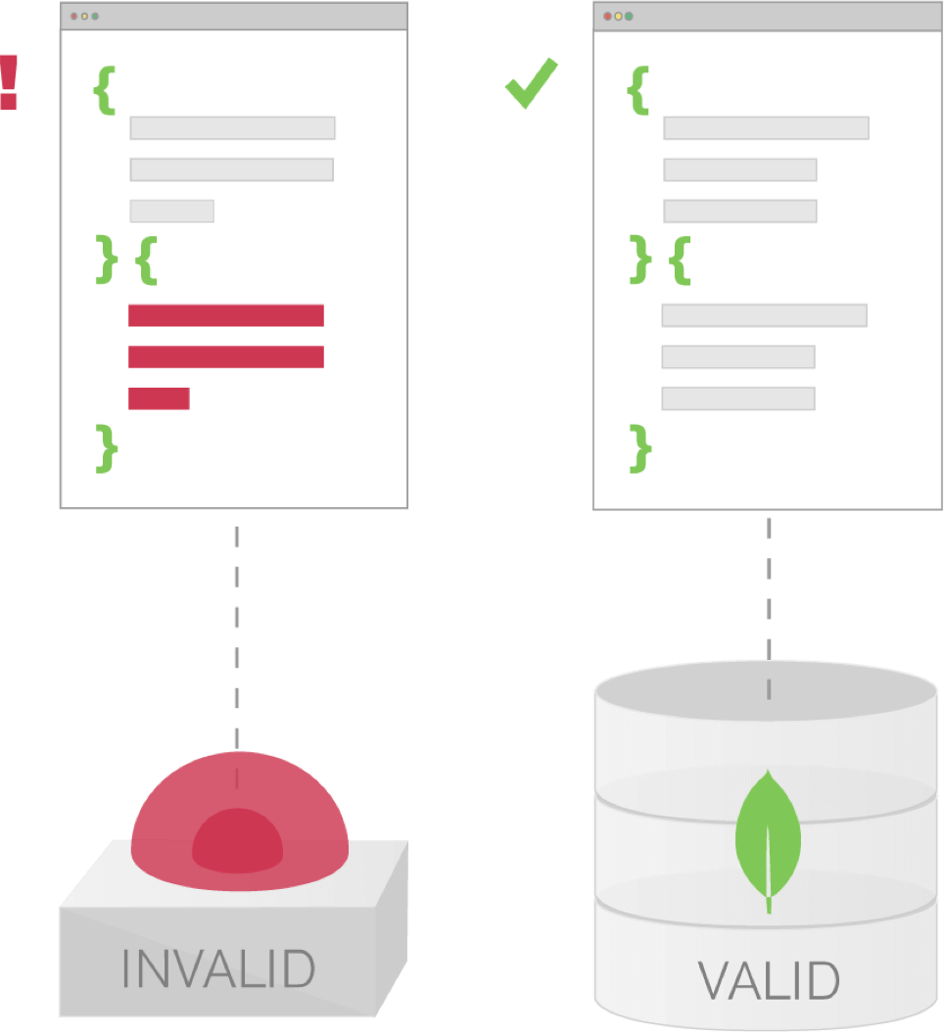
Data Governance with Document Validation
Implement data governance without sacrificing agility that comes from dynamic schema
Enforce data quality across multiple teams and applications
Use familiar MongoDB expressions to control document structure
Validation is optional and can be as simple as a single field, all the way to every field, including existence, data types, and regular expressions

Slide 18
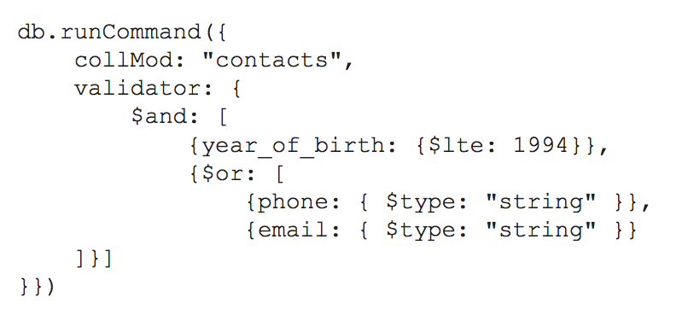
Document Validation Example
The example on the left adds a rule to the contacts collection that validates:
The year of birth is no later than 1994
The document contains a phone number and / or an email address
When present, the phone number and email addresses are strings

Slide 19
Expressive Query Language & Secondary Indexes, In-database Analytics

Slide 20
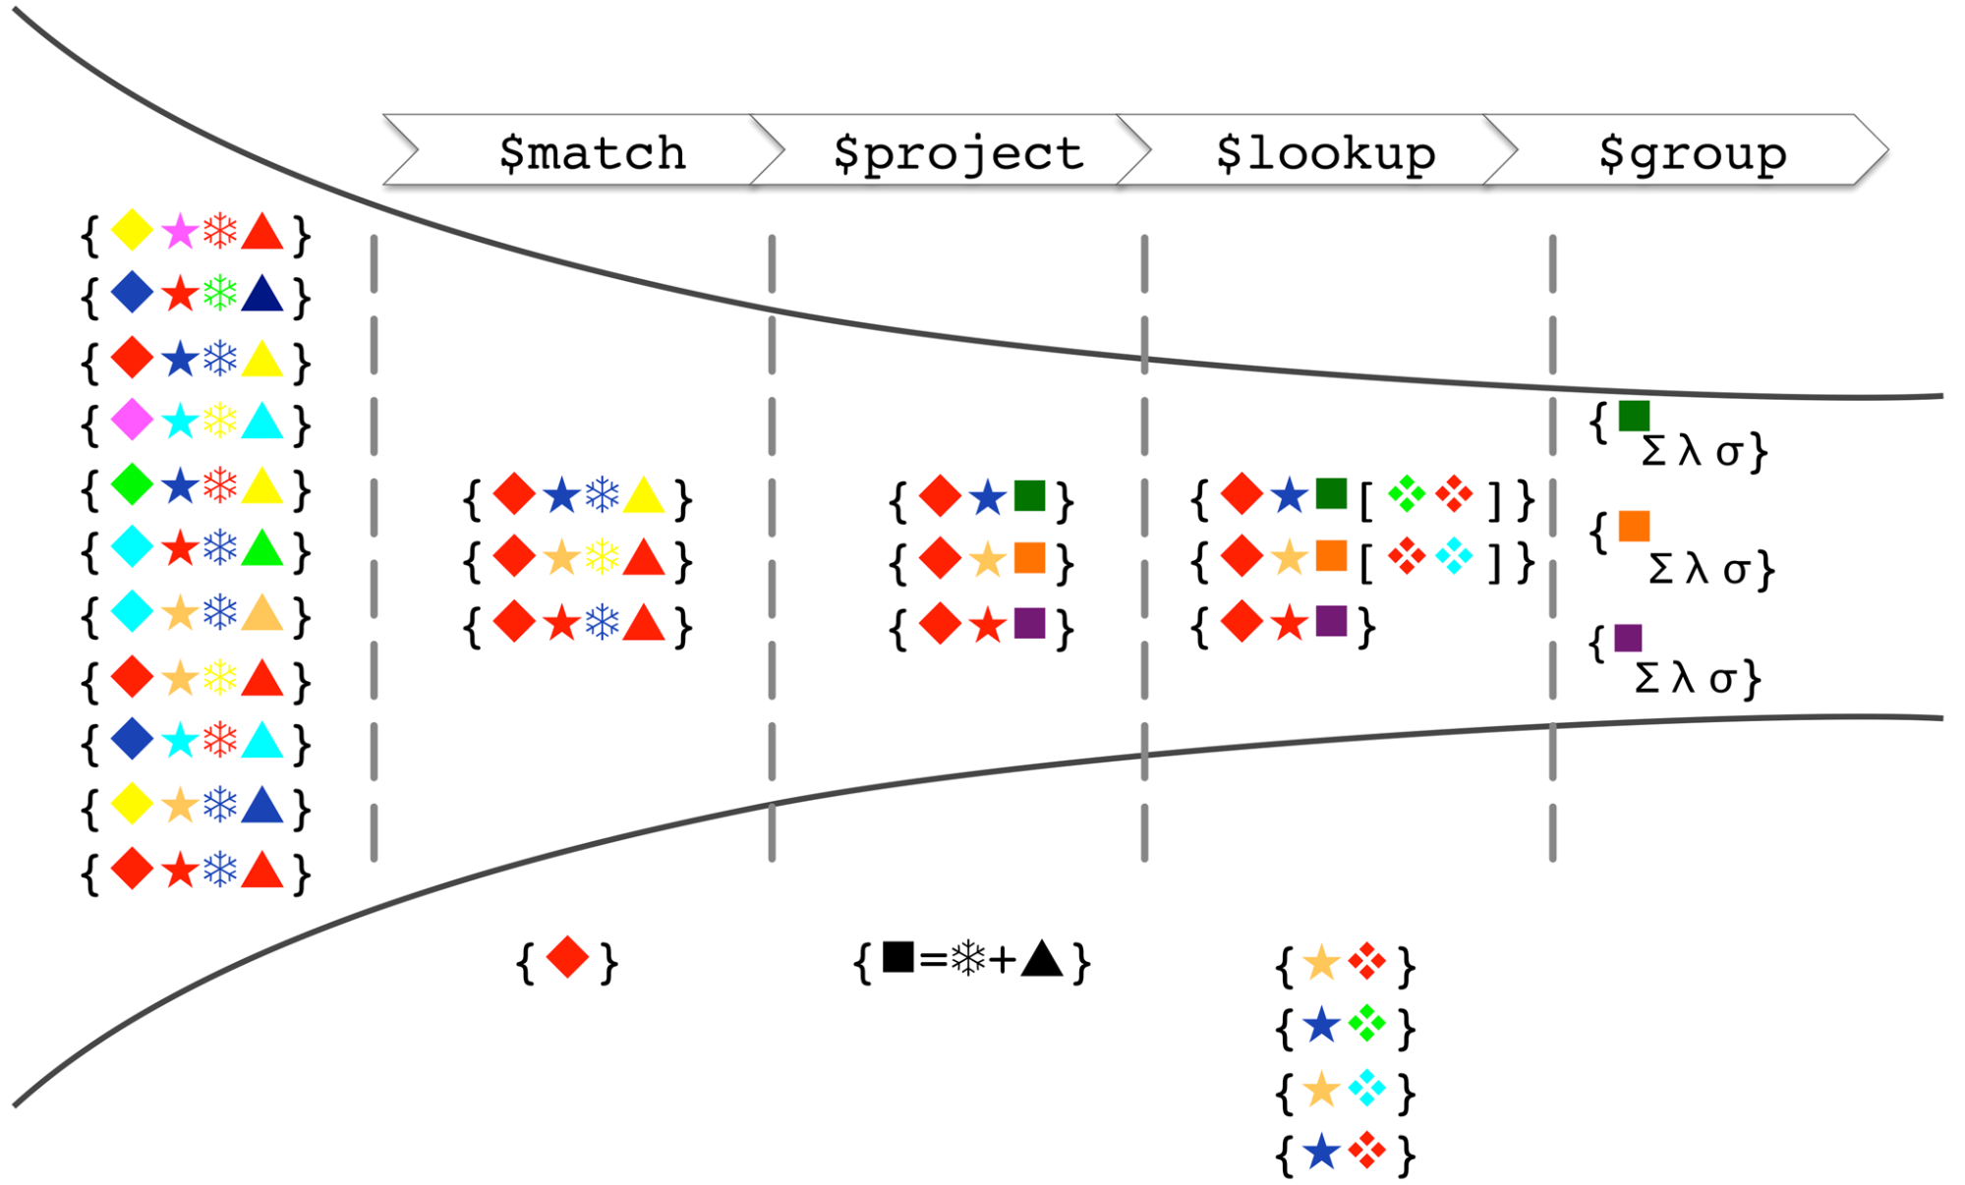
Model of the Aggregation Framework
Notes:
Start with the original collection; each record (document) contains a number of shapes (keys), each with a particular color (value)
$match filters out documents that don’t contain a red diamond
$project adds a new “square” attribute with a value computed from the value (color) of the snowflake and triangle attributes
$lookup performs a left outer join with another collection, with the star being the comparison key
Finally, the $group stage groups the data by the color of the square and produces statistics for each group

Slide 21
Richer In-Database Analytics & Search
Array Operators | Math Operators | Text
$slice $arrayElemAt $concatArrays $filter $min $max $avg $sum and more … | $stdDevSamp $stdDevPop $sqrt $abs $trunc $ceil $floor $log $pow $exp and more … | Case sensitive text search Support for languages such as Arabic, Farsi, Chinese and more …
New Aggregation operators extend options for performing analytics with lower developer complexity

Slide 22
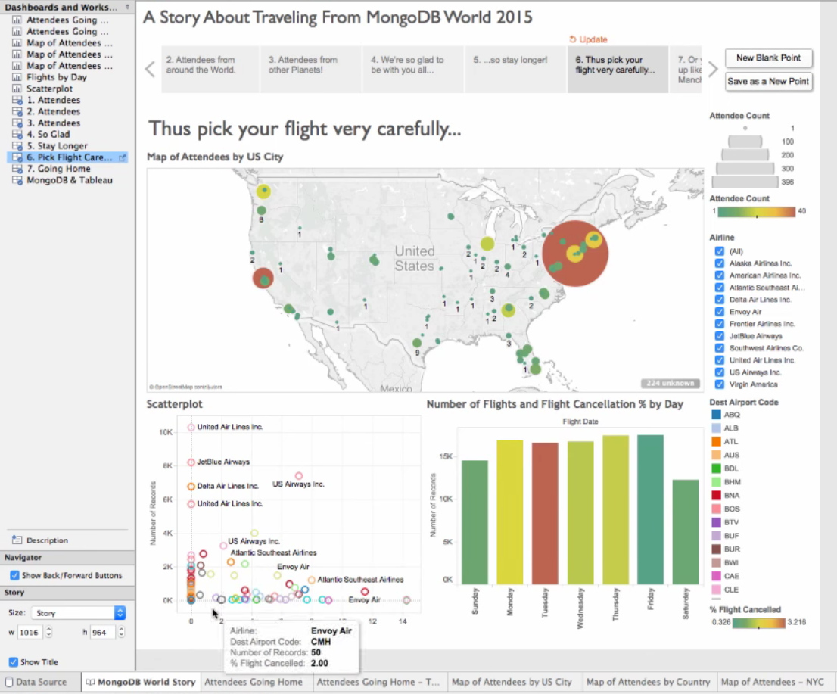
MongoDB Connector for BI
Visualize and explore multi-dimensional documents using SQL-based BI tools. The connector does the following:
Provides the BI tool with the schema of the MongoDB collection to be visualized
Translates SQL statements issued by the BI tool into equivalent MongoDB queries that are sent to MongoDB for processing
Converts the results into the tabular format expected by the BI tool, which can then visualize the data based on user requirements

Slide 23
Multi-Modal

Slide 24
Storage Engine API
Content Repo
IoT Sensor Backend
Ad Service
Customer Analytics
Archive
MongoDB Query Language (MQL) + Native Drivers
Security
MongoDB Document Data Model
Management
WT
MMAP
In-memory (beta)
Encrypted
3rd party
Supported in MongoDB 3.2

Slide 25
High Availability & Uptime

Slide 26
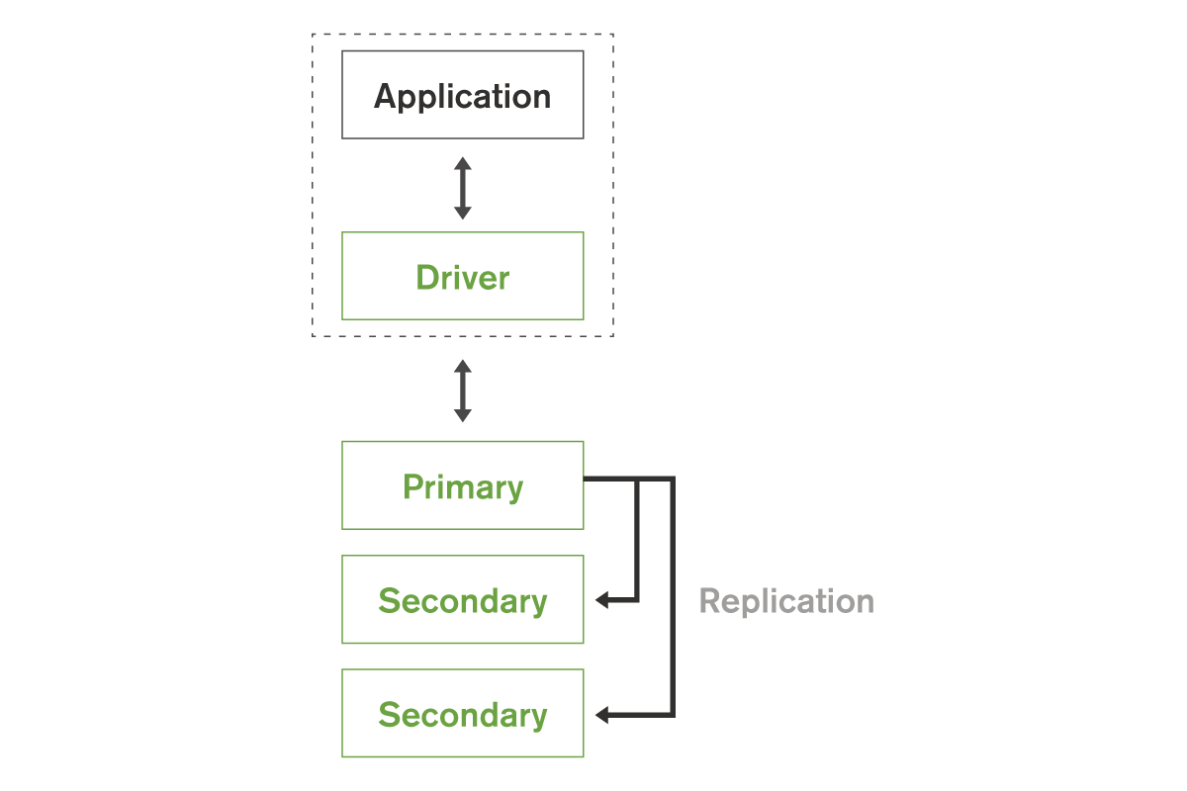
Replica Sets
Replica set – 2 to 50 copies
Makes up a self-healing ‘shard’
Data center aware
Addresses:
High availability
Data durability, consistency
Maintenance (e.g., HW swaps)
Disaster Recovery
A Single
Shard
Notes:
High Availability – Ensure application availability during many types of failures
Meet stringent SLAs with fast-failover algorithm
Under 2 seconds to detect and recover from replica set primary failure
Disaster Recovery – Address the RTO and RPO goals for business continuity
Maintenance – Perform upgrades and other maintenance operations with no application downtime
Secondaries can be used for a variety of applications – failover, hot backup, rolling upgrades, data locality and privacy and workload isolation

Slide 27
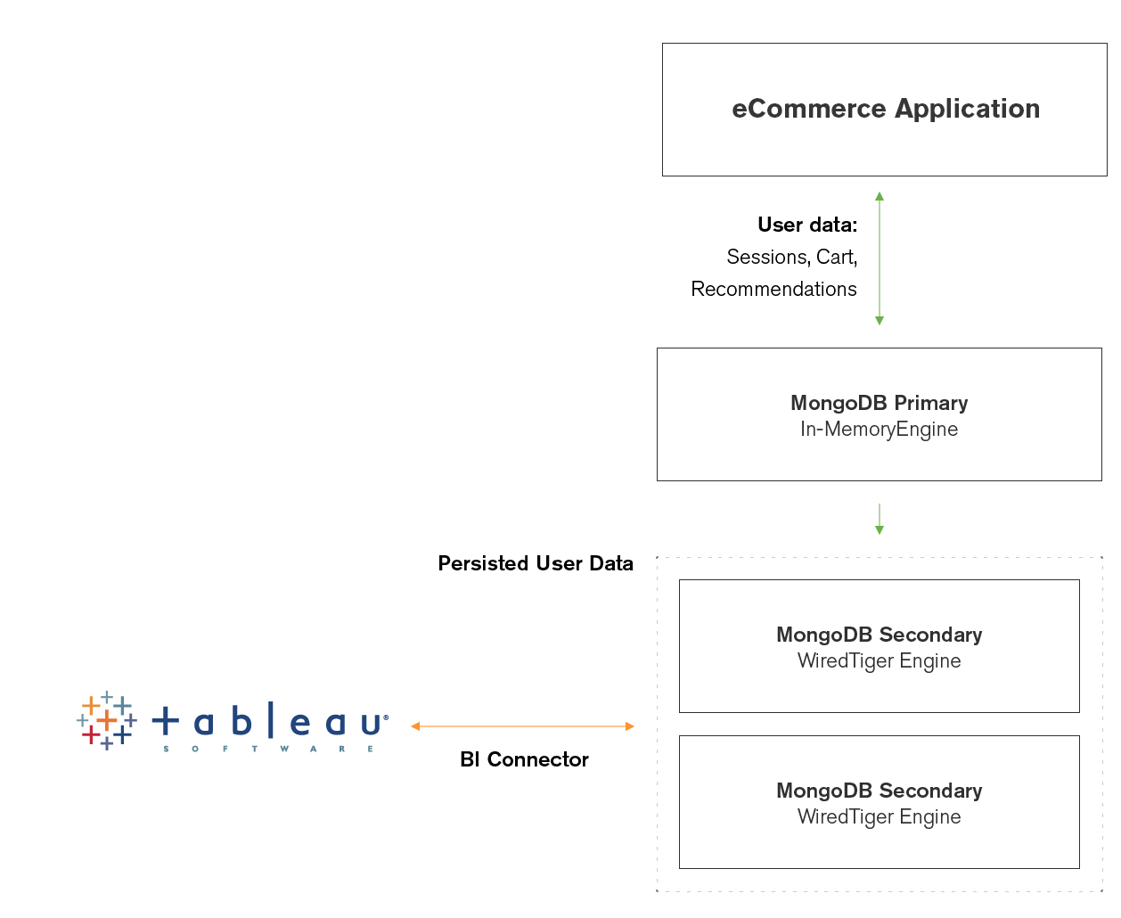


Replica Sets – Workload Isolation
Replica sets enable workload isolation.
Example: Operational workloads on the primary node, analytical workloads on the secondary nodes

Slide 28
Elastic Scalability

Slide 29
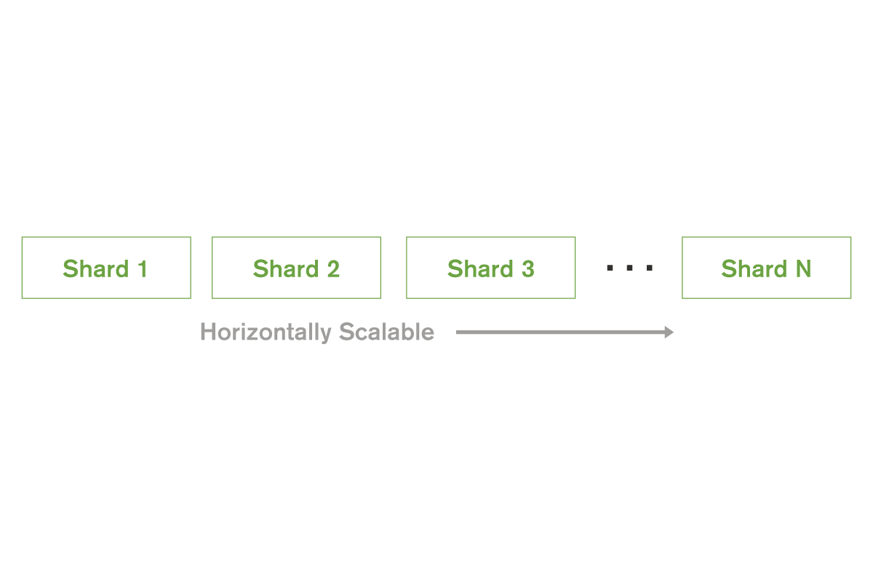
Elastic Scalability with Automatic Sharding
Increase or decrease capacity as you go
Automatic load balancing
Three types of sharding
Hash-based
Range-based
Tag-aware
Notes:
MongoDB provides horizontal scale-out for databases using a technique called sharding, which is trans- parent to applications. Sharding distributes data across multiple physical partitions called shards. Sharding allows MongoDB deployments to address the hardware limitations of a single server, such as bottlenecks in RAM or disk I/O, without adding complexity to the application.
MongoDB automatically balances the data in the cluster as the data grows or the size of the cluster increases or decreases.
MongoDB supports three types of sharding:
• Range-based Sharding. Documents are partitioned across shards according to the shard key value. Documents with shard key values “close” to one another are likely to be co-located on the same shard. This approach is well suited for applications that need to optimize range- based queries.
• Hash-based Sharding. Documents are uniformly distributed according to an MD5 hash of the shard key value. Documents with shard key values “close” to one another are unlikely to be co-located on the same shard. This approach guarantees a uniform distribution of writes across shards, but is less optimal for range-based queries.
• Tag-aware Sharding. Documents are partitioned according to a user-specified configuration that associates shard key ranges with shards. Users can optimize the physical location of documents for application requirements such as locating data in specific data centers.

Slide 30
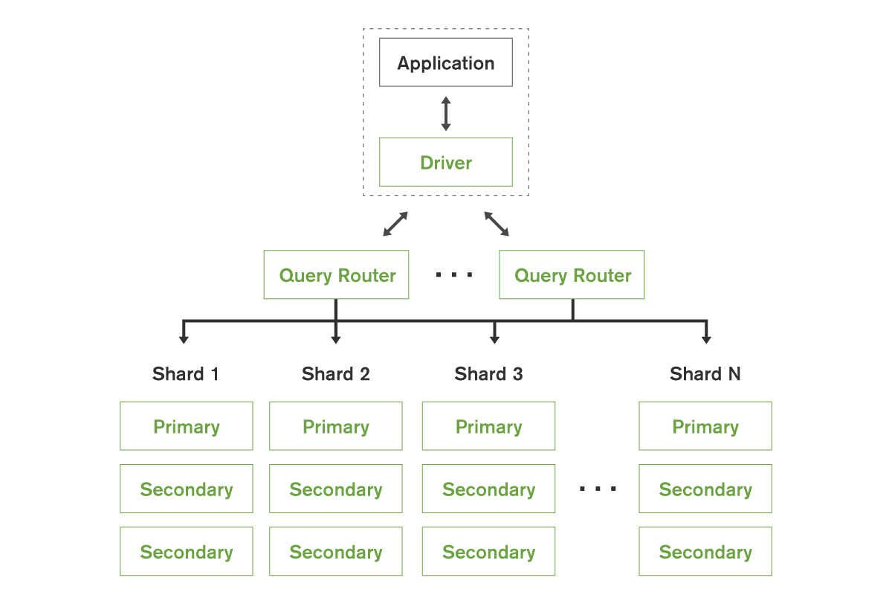
Query Routing
Multiple query optimization models
Each of the sharding options are appropriate for different apps / use cases
Notes:
Sharding is transparent to applications; whether there is one or one hundred shards, the application code for querying MongoDB is the same. Applications issue queries to a query router that dispatches the query to the appropriate shards.
For key-value queries that are based on the shard key, the query router will dispatch the query to the shard that manages the document with the requested key. When using range-based sharding, queries that specify ranges on the shard key are only dispatched to shards that contain documents with values within the range. For queries that don’t use the shard key, the query router will dispatch the query to all shards and aggregate and sort the results as appropriate. Multiple query routers can be used with a MongoDB system, and the appropriate number is determined based on performance and availability requirements of the application.

Slide 31
Performance at Scale
 | Top 5 Marketing Firm | Government Agency | Top 5 Investment Bank
Data | Key / Value | 10+ fields, arrays, nested documents | 20+ fields, arrays, nested documents
Queries | Key-based 1-100 docs/query 80/20 read/write | Compound queries Range queries MapReduce 20/80 read/write | Compound queries Range queries 50/50 read/write
Servers | ~250 | ~50 | 4
Operations / Second | 1,200,000 | 500,000 | 30,000
Notes:
The figures above are examples. Your application will govern your performance.

Slide 32






Performance at Scale
Entertainment Co.
Cluster Scale |  | Performance Scale |  | Data Scale
Entertainment Co. | 1400 servers |  | 250M Ticks / Sec |  | Petabytes
Asian Internet Co. | 1000+ servers |  | 300K+ Ops / Sec |  | 10s of billions of objects
 | 250+ servers | Fed Agency | 500K+ Ops / Sec |  | 13B documents
Notes:
The figures above are examples. Your application will govern your performance.

Slide 33





















MongoDB Use Cases
Single View
Internet of Things
Mobile
Real-Time Analytics
Catalog
Personalization
Content Management

Slide 34
Flexible Data Distribution

Slide 35
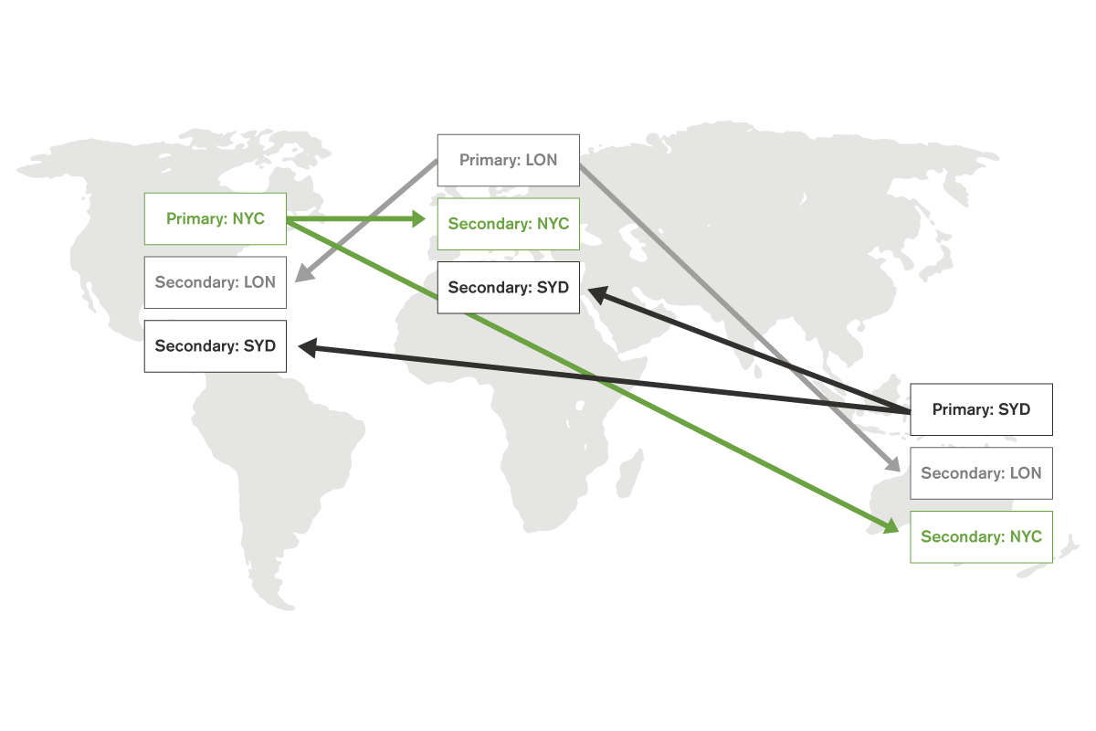
Read Global / Write Local

Slide 36
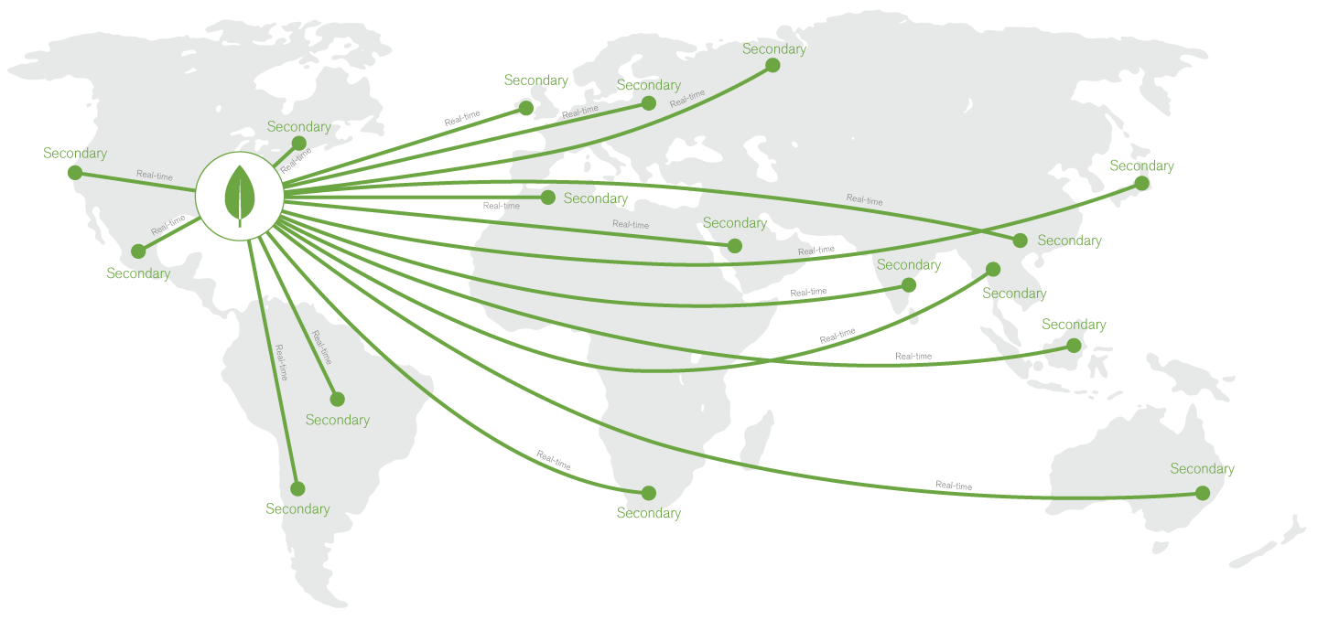
Replicate Data Near Users

Slide 37
Security

Slide 38
Enterprise-Grade Security
BUSINESS NEEDS | SECURITY FEATURES
Authentication | SCRAM, LDAP*, Kerberos*, x.509 Certificates
Authorization | Built-in Roles, User-Defined Roles, Field-Level Redaction
Auditing* | Admin, DML, DDL, Role-based
Encryption | Network: SSL (with FIPS 140-2), Disk: Encrypted Storage Engine* or Partner Solutions
*Included with MongoDB Enterprise Advanced

Slide 39
Management Platform & Tools

Slide 40
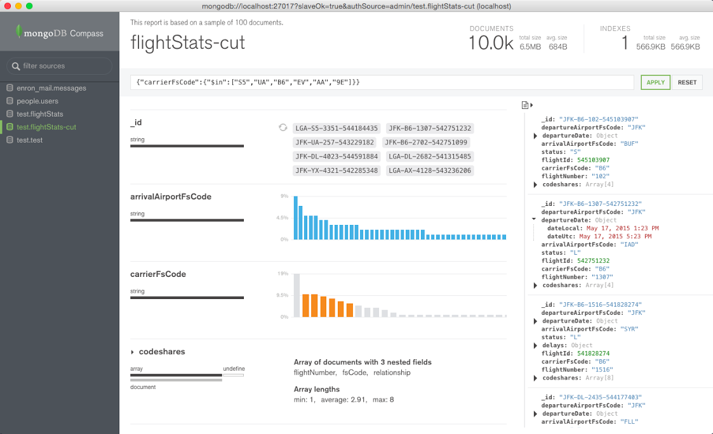
Compass: The GUI for MongoDB
Visually explore your data. Run ad hoc queries in seconds.
Compass empowers you to make smarter decisions about indexing, document validation, and more.
No command line needed.
Notes:
Visualize schema
Frequency of fields
Frequency of types
Determine validator rules
View Documents
Graphically build queries
Authenticated access

Slide 41
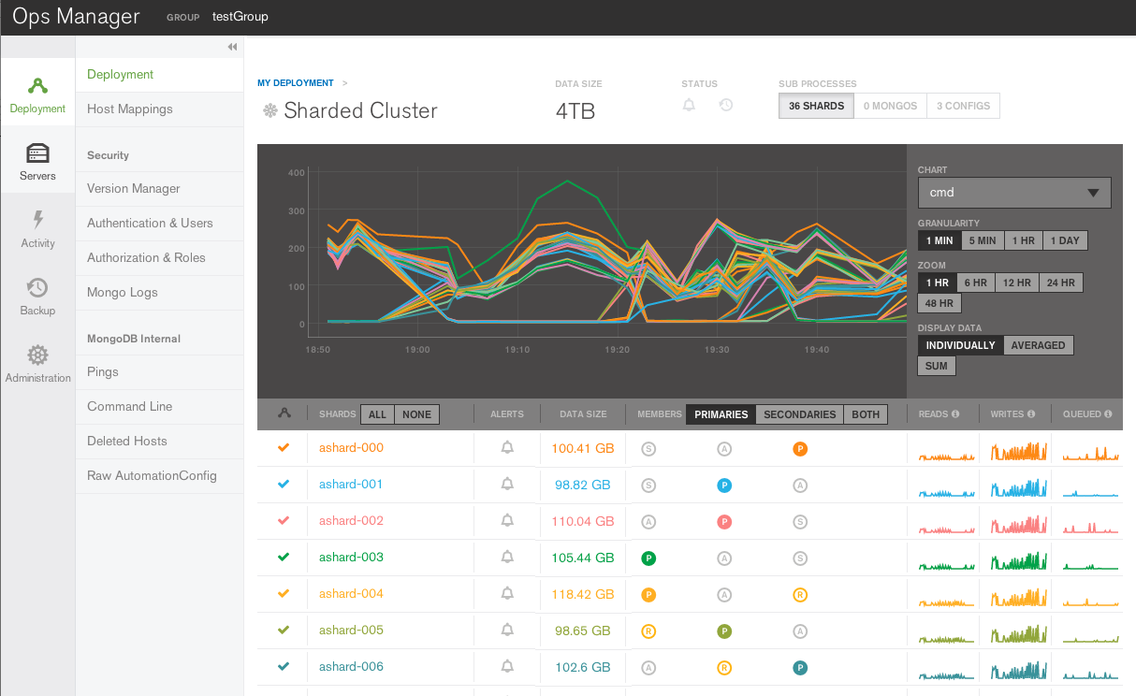
How It Works
Ops Manager
Agent
Agent
Agent
mongod
mongod
mongod
Notes:
Ops Manager agents are installed on servers (where MongoDB will be deployed), either through configuration tools such as Chef or Puppet, or by an administrator.
The administrator creates a new design goal for the system, either as a modification to an existing deployment (e.g., upgrade, oplog resize, new shard), or as a new system.
The agents periodically check in with the Ops Manager central server and receive the new design instructions.
Agents create and follow a plan for implementing the design. Using a sophisticated rules engine, agents continuously adjust their individual plans as conditions change. In the face of many failure scenarios – such as server failures and network partitions – agents will revise their plans to reach a safe state.
Minutes later, the system is deployed – safely and reliably.

Slide 42
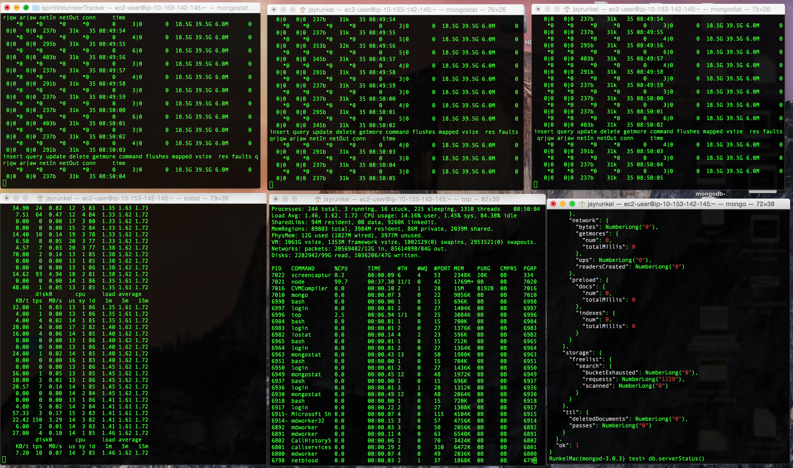
Monitoring: Without Ops Manager
Notes:
monogstat
iostat
top
mtools
munin node
Open em all up -- MANY TABS and WINDOWS

Slide 43
Monitoring: With Ops Manager
Track 100+ metrics (e.g., memory, locks)
Dozens of charts
Alerts
PLUS
APIs to for APM integration
Out of the box integration with New Relic
A much easier way to optimize performance, plan for capacity, and diagnose problems.

Slide 44
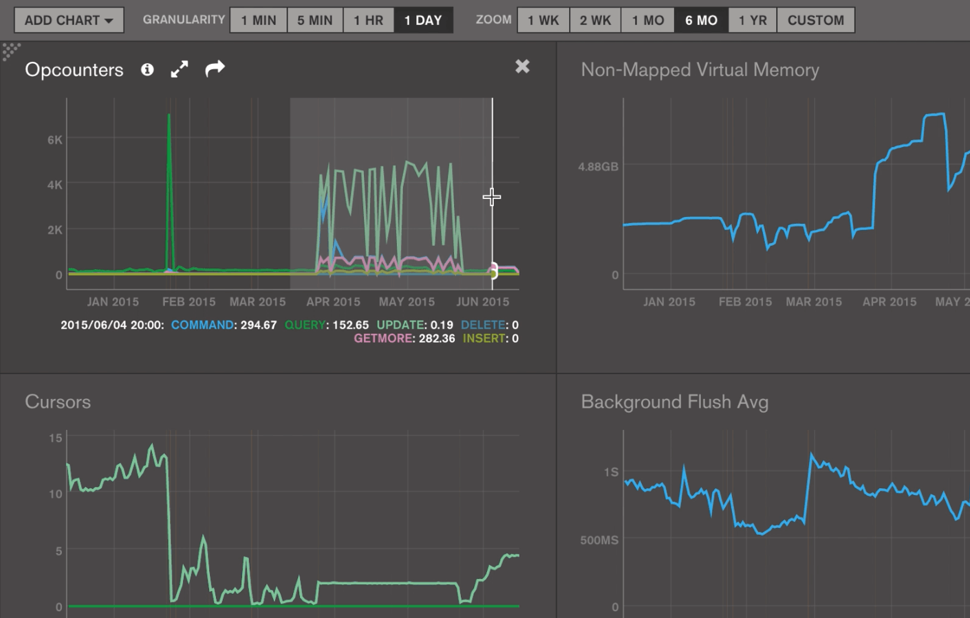
Monitoring: Ops Manager UI

Slide 45
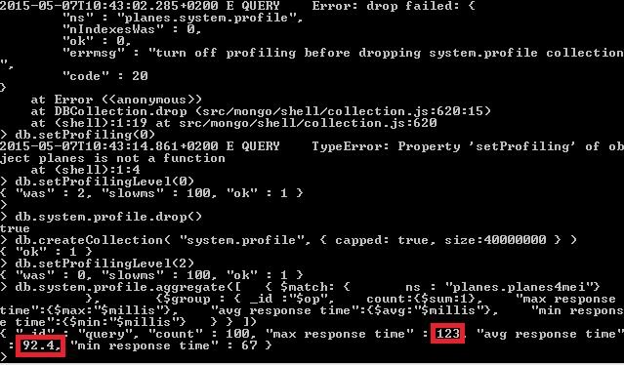
Query Optimization: Without Ops Manager (VQP)
Notes:
MongoDB “Profiler” is a database profiling system that can help identify inefficient queries and operations.
Must be enabled in the mongo shell
Database profiler can itself negatively impact performance so it is advisable to only enable profiling for strategic intervals and as minimally as possible on production systems
Output of the profiler can be viewed in the system.profile collection of the database by issuing commands through the mongo shell
Use the $query operator to access the query field of documents within system.profile

Slide 46
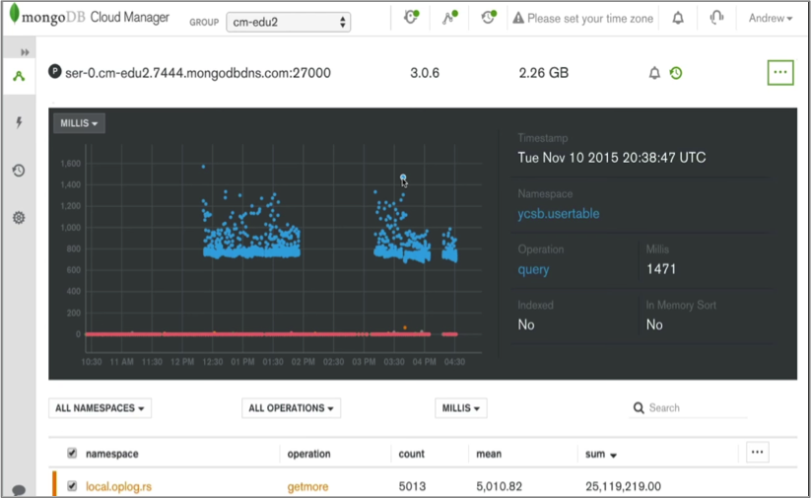
Query Optimization: With Ops Manager (VQP)
Notes:
The Visual Query Profiler allows ops teams to easily identify their slow-running queries.
It displays how query and write latency vary over time.
With just a click of a button, the Visual Query Profiler consolidates and displays metrics from all nodes on a single screen.

Slide 47

Query Optimization: Without Ops Manager (Index Suggestions)
Notes:
They’re on their own.

Slide 48
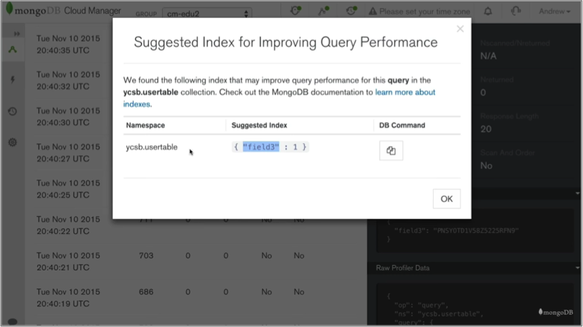
Query Optimization: With Ops Manager (Index Suggestions)
Notes:
Ops Manager delivers index recommendations to improve the performance the database.
More specifically, the Visual Query Profiler analyzes the data it shows ops teams and presents them with recommendations for new indexes that can be created to improve the performance of their deployments.

Slide 49
Query Optimization: Without Ops Manager (Automated Index Roll Outs)
For a replica set:
Stop one secondary
Build the index
Restart the program mongod
Build indexes on all secondaries
For each secondary in the set, build an index according to the following steps:
Stop one secondary
Build the index
Restart the program mongod
Build the index in the background on the primary
Step down the primary using rs.stepDown() method in the mongo shell to cause the current primary to become a secondary gracefully and allow the set to elect another member as primary.
Then repeat the index building procedure, listed below, to build the index on the primary:
Stop One Secondary
Build the Index
Restart the Program mongod
Even more complicated to build an index in a sharded cluster!
Full description of recommended process can be found here: https://docs.mongodb.org/manual/tutorial/build-indexes-on-replica-sets/#tutorial-index-on-replica-sets-stop-one-member

Slide 50
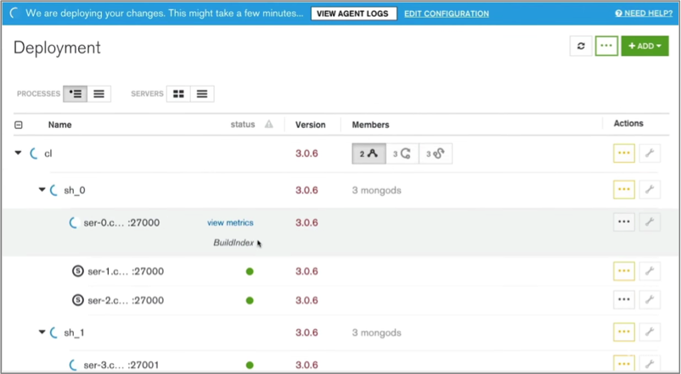
Query Optimization: With Ops Manager (Automated Index Roll Outs)
Notes:
Ops Manager can initiate automated rolling index builds to reduce the operational overhead of rolling out new indexes.
Once identified, the indexes from part 2 need to be rolled out in the production system.
In order to minimize the impact to the live system, the best practice is to perform a rolling index build – starting with each of the secondaries and finally applying changes to the original primary, after swapping its role with one of the secondaries.
While this rolling process can be performed manually, Ops Manager can automate the process across MongoDB replica sets, reducing operational overhead and the risk of failovers caused by incorrectly sequencing management processes.

Slide 51
Automation: Database Mgmt Basics
It can take a lot of manual effort to care for a MongoDB system in production
Install + Configure
150+ steps
Error handling, throttling, alerts
Deploy
Upgrade
Upgrades, downgrades
100+ steps
Error handling, throttling, etc
Maintenance
Scale out, move servers, resize oplog, etc
10 - 180+ steps
Error handling, throttling, etc

Slide 52
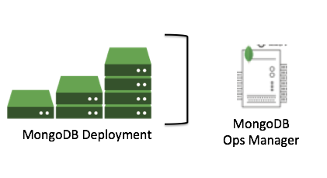
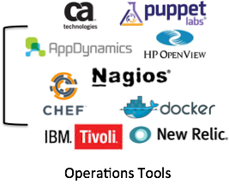
Automation: There are a couple of ways to manage
Manual (worst) – lots of work, subject to human error
Custom Scripts (less bad) – lots of work, and work to maintain
Database-Specific Mgt. Tool (not bad, not great) – use Ops Manager to push a button, best practices built in
Mgt. Software They Already Use (best) – push a button in the “pane of glass” they already use, but take advantage of all the benefits of Ops Manager via API
Ops Manager API

Slide 53
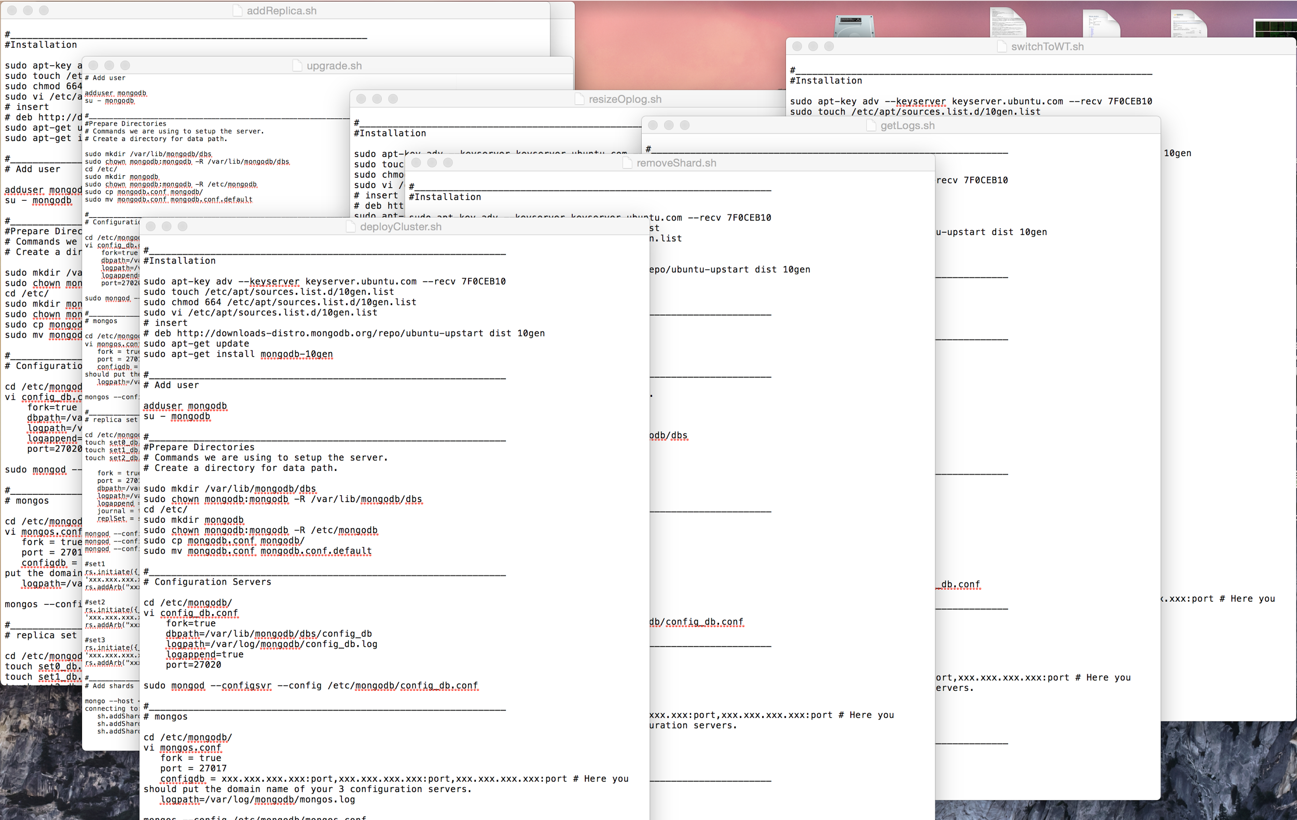
Automation: Without Ops Manager
Notes:
Maintenance tasks -- best practices, script to write/debug/test/maintain, etc.
- Adding a shard (dozens of steps)
- Removing a shard (dozens of steps)
- Upgrades (waiting and checking)
- Resizing the oplog
- Changing configurations
- Getting access to the logs (where is it?)
- Add a replica
- Hundreds of others
Hundreds of steps and syntax to remember

Slide 54
Automation: With Ops Manager
Automate deploying, upgrading, growing MongoDB deployments
150+ manual steps → 1 click of a button
Ops Manager API for orchestration tools (Chef, Puppet)
Auto-provision on AWS (Cloud Manager only)
Ops Manager: 10-20x more efficient in managing your database.

Slide 55
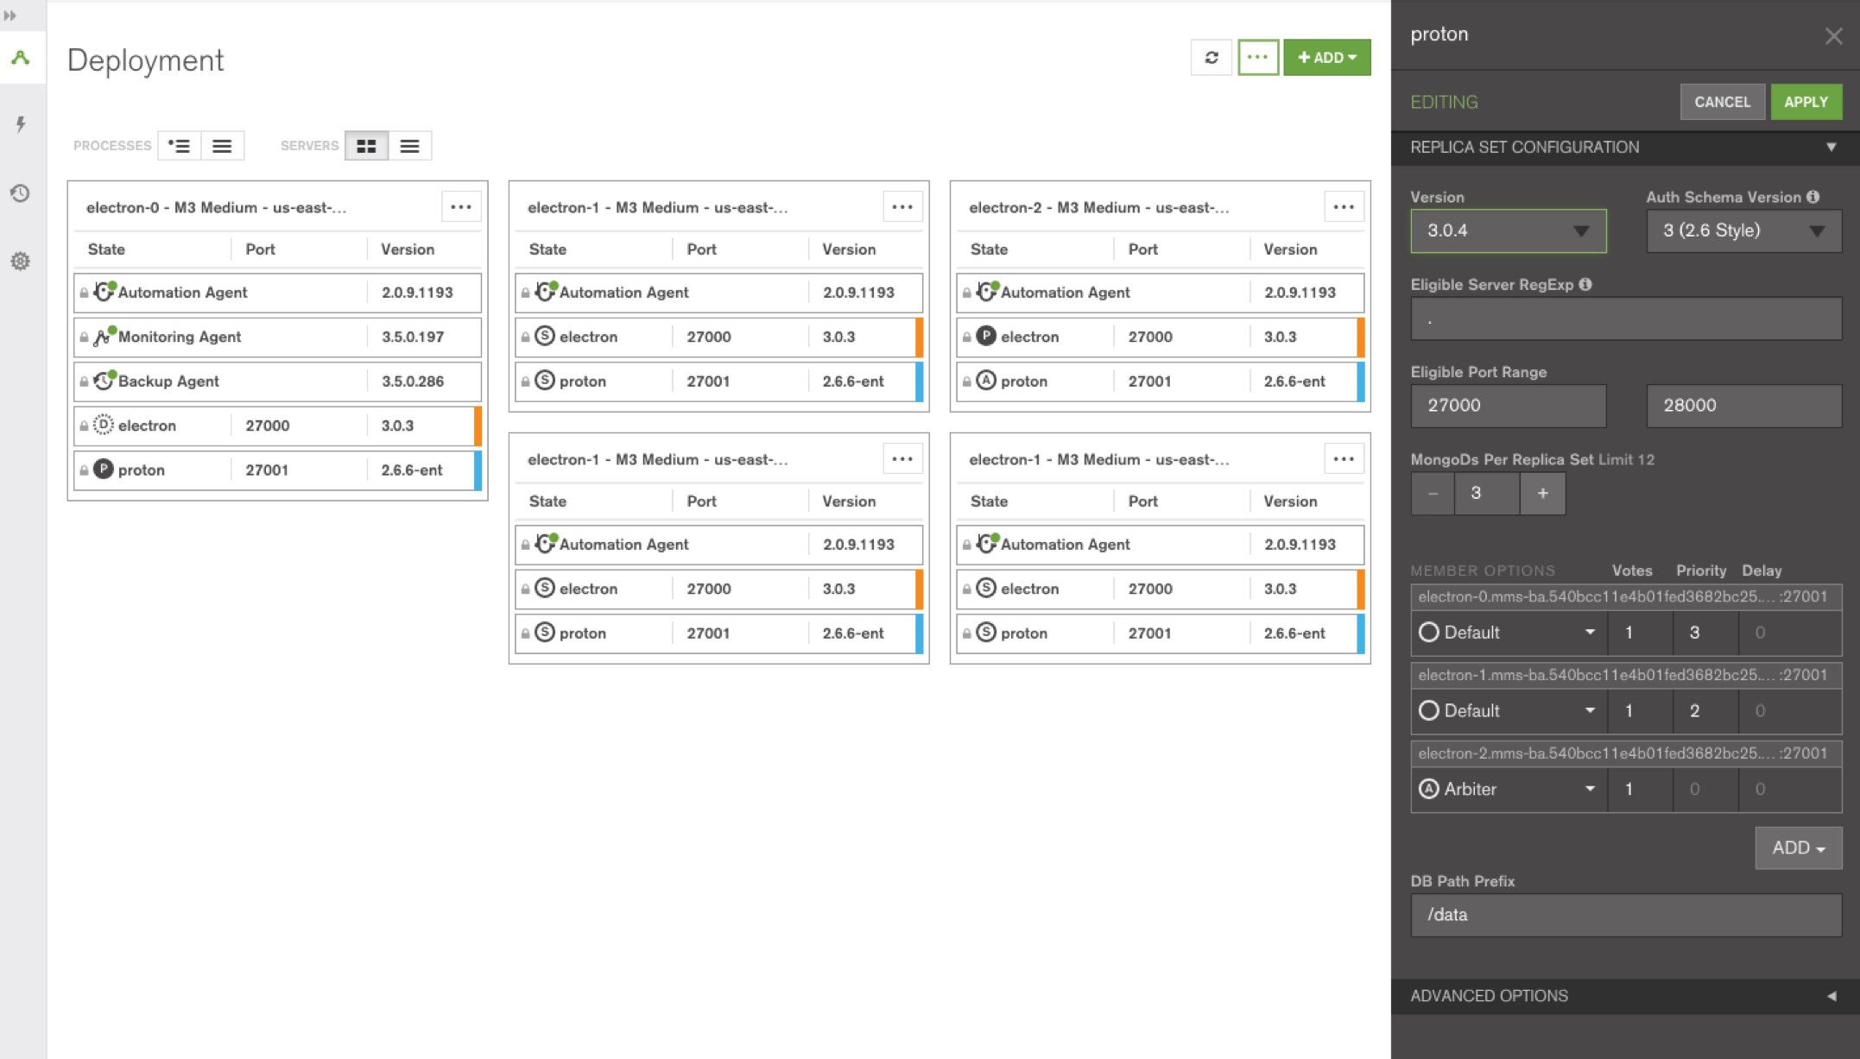
Automation: Ops Manager UI

Slide 56
Ops Manager: Backup

Slide 57
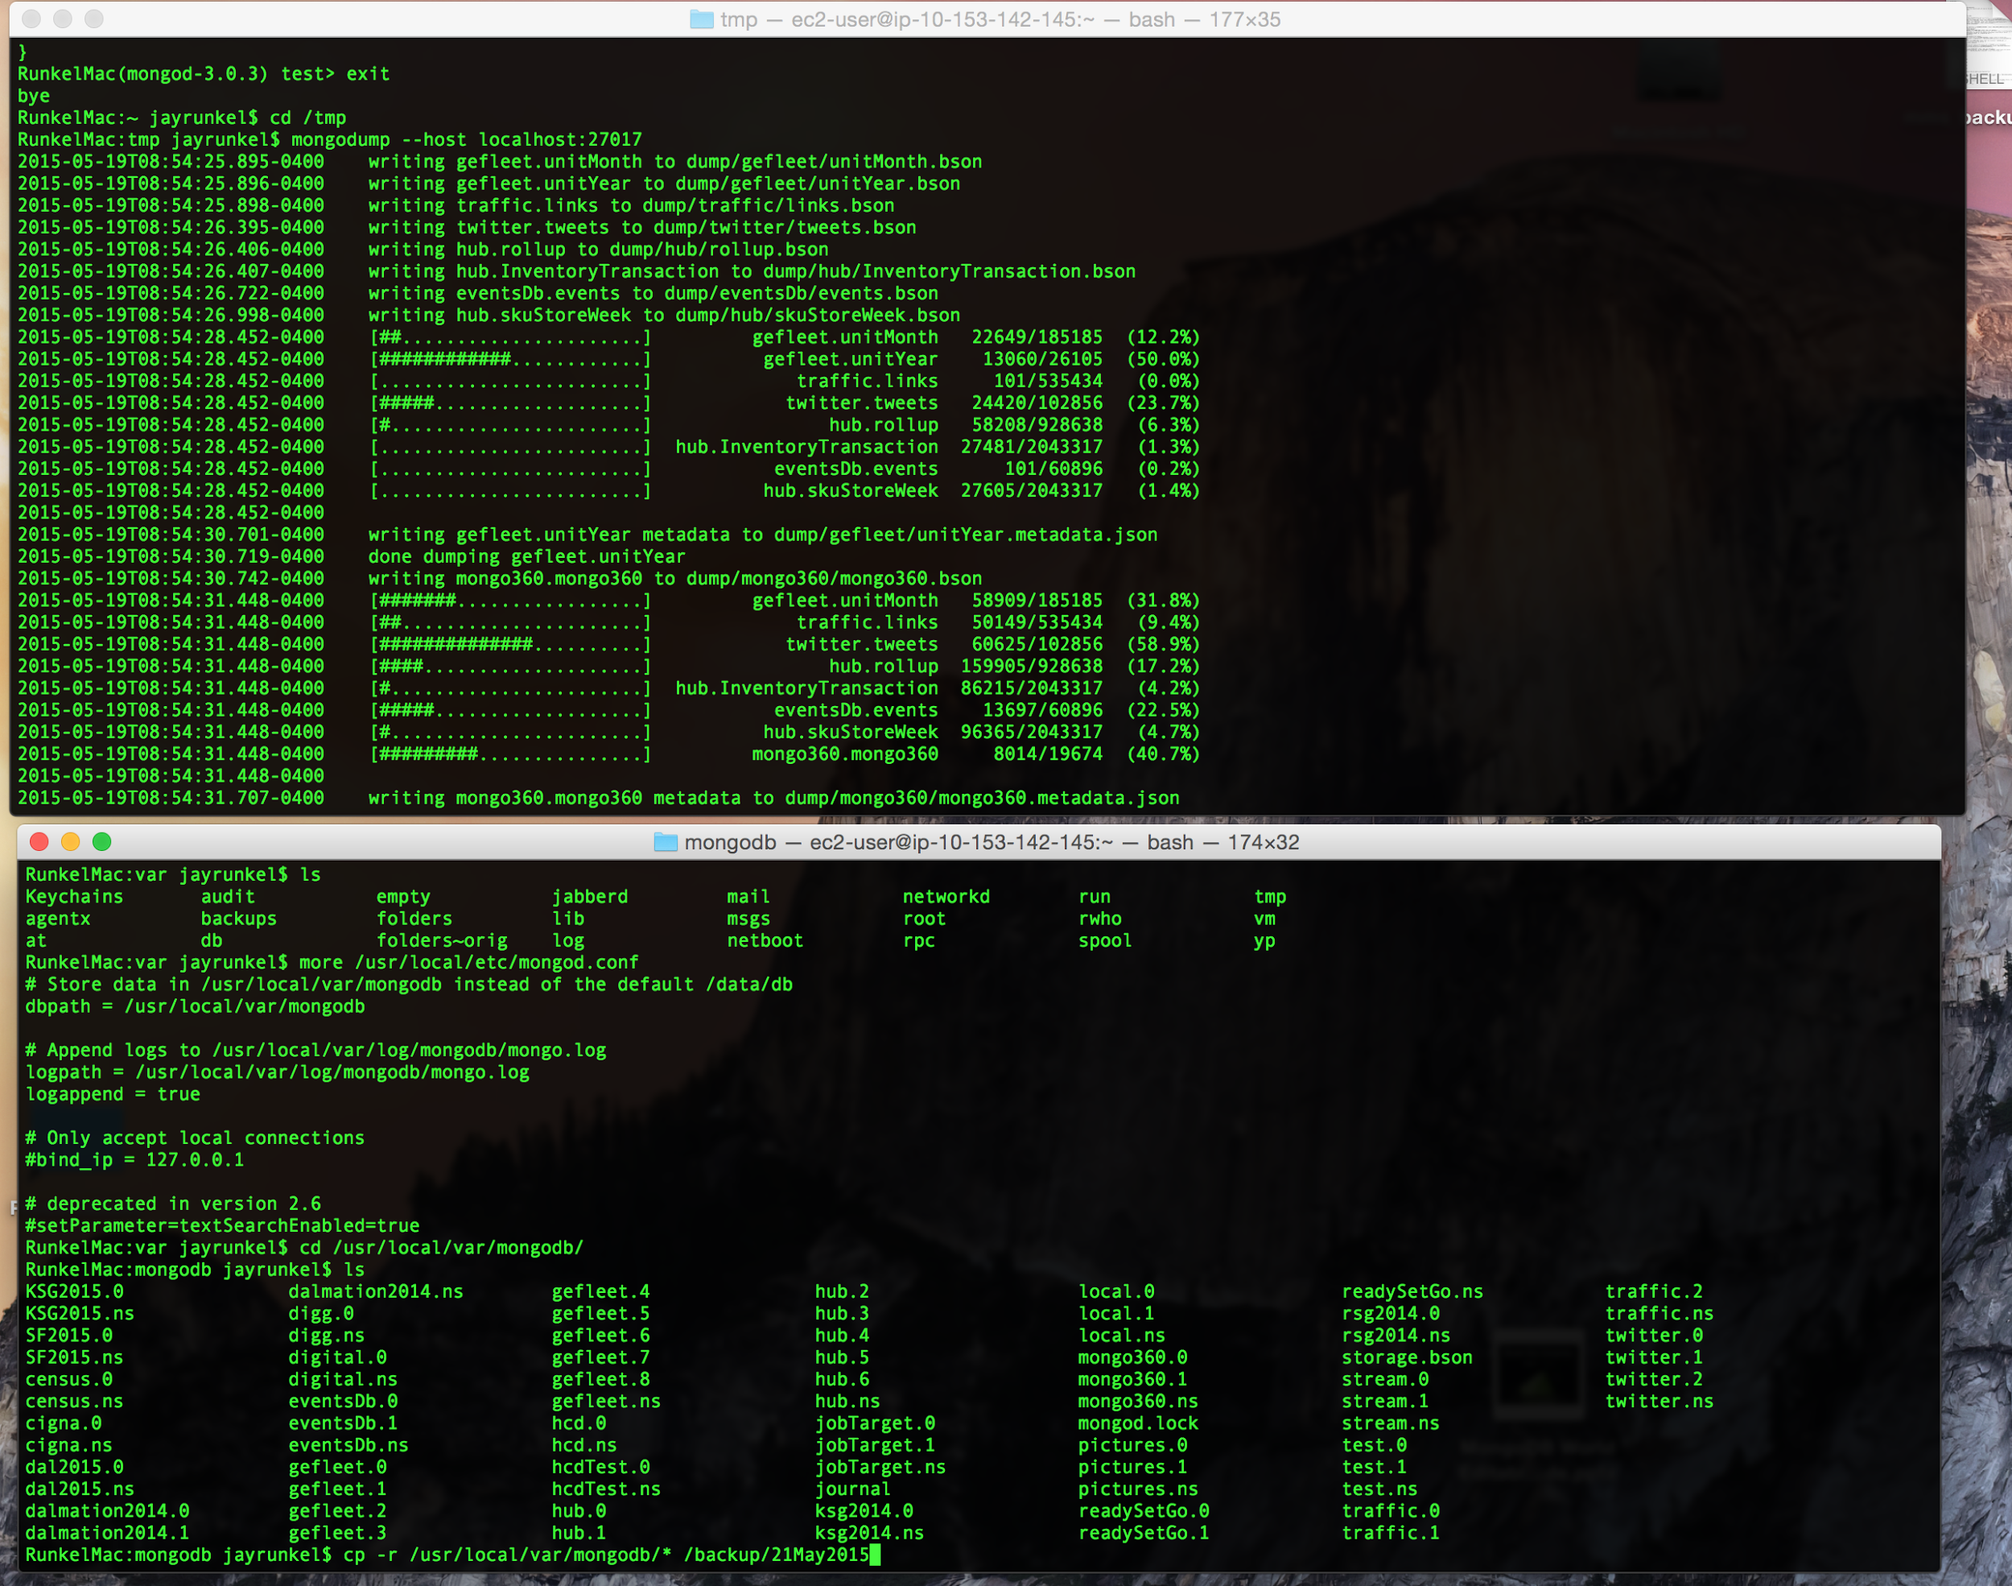
Backups: Without Ops Manager
Custom scripting
Dozens of key tasks / steps
Hundreds of lines of code
Notes:
- Mongodump (takes a long time -- doesn’t scale)
- Filesystem snapshot (doesn’t work with sharding)
...custom scripting
Limitations
- None of these is point in time
- Not consistent
Can’t use third-party backup tools with MongoDB
In sharded cluster…
- turn off the balancer
- connect to mongos
- mongodump
- dump the oplog manually for each shard
- manually reconfigure the nodes
- restore the data to each mongod
- replay the oplog manually for each shard -- but no real way to know that they’re synchronized
Dozens of key tasks/steps
HUNDREDS of lines of code
Edge cases: server crash, network failure; rollback; chunk migration
If you screw them up, your backup is useless

Slide 58
Backups: Without Ops Manager (Manual)
mongodump
schedule manually
takes a loooong time
must manage/archive resulting files
for consistency, need to save oplog too!
with shards:
dump all at the exact same time - good luck
no point in time recovery
Copy MongoDB data directory
schedule manually
takes a loooong time
mongodb must be stopped during copy
can use secondary
must manage/archive resulting files
with shards:
copy all at the exact same time - good luck
no point in time recovery
File system snapshot of directory
schedule manually
mongodb must be stopped during copy
can use secondary
must manage/archive resulting files
with shards:
copy all at the exact same time - good luck
no point in time recovery

Slide 59
Backups: With Ops Manager
Backup your data - continuous, real-time
Point-in-time recovery of replica sets
Cluster-wide snapshots of sharded clusters
Fast and seamless recovery
...all with a few clicks in the Ops Manager UI
Ops Manager: Safer, more reliable, and easier

Slide 60
MongoDB as Service

Slide 61



Value of MongoDB as a Service
Standardize operations across multiple MongoDB deployments
Integrate MongoDB into your environment and tooling
Speed development with a fast and easy dev/test sandbox
Reduce costs and complexity while reducing time to production

Slide 62
MongoDBaaS Architecture Diagram
Applications
MongoDB
Cluster
4GB RAM
2cores
MMAPv1 + 100 GB
Tier 1
RS A
…
Tier 1
RS N
4 GB RAM
2cores
WT + 20 GB
MongoDB Driver
mongos
27017
mongos
27017
mongos
27017
mongos
27017
8 GB RAM
2 cores
40 GB / 200 GB
Tier 2
RS A
…
Tier 2
RS N
16 GB RAM
4 cores
80 GB / 500 GB
mongod
27018
mongod
27017
Tier 3
RS A
…
Tier 3
RS N
mongod
27018
mongod
27018
config
27019
mongod
27018
mongod
27017
config
27019
32 GB RAM
4 cores
160 GB / 1 TB
mongod
27018
mongod
27018
Tier 4
RS A
…
Tier 4
RS N
config
27019
mongod
27018
mongod
27017
mongod
27018
mongod
27018
64 GB RAM
8 cores
320 GB / 2 TB
Tier 5
RS A
…
Tier 5
RS N
Ops Manager: Automation, Monitoring & Backup
One single MongoDB Cluster:
Each replicaset is a shard
Easy to administer
Easy to differentiate (i.e. config per app/server)
Easy to uplift databases as they grow
No sharded collections (<2TB)
Not designed for apps that require dedicated resources
Ops Manager in command of operations:
Servers are added using images (VMWare, Docker, etc.) including the automation agent
Easier to implement corporate security policies
Multi tenancy at hardware level
Dynamic allocation by layer based on resource need

Slide 63





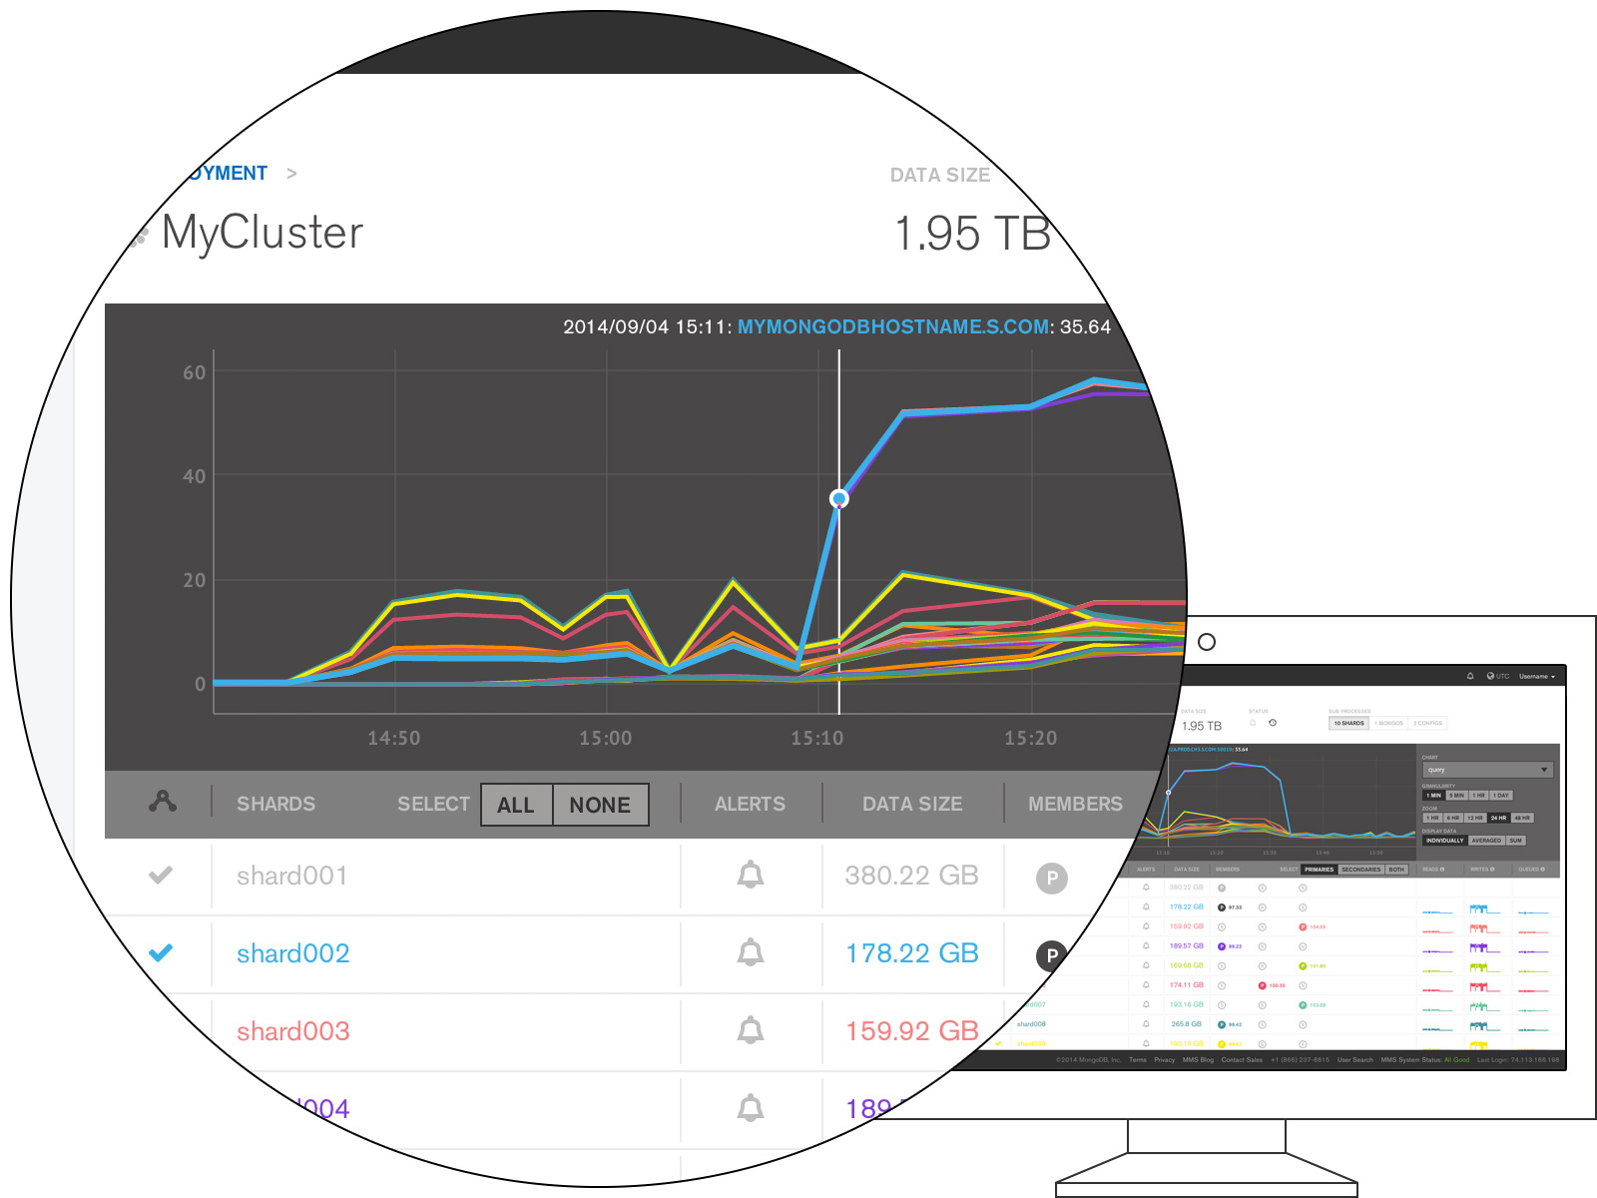
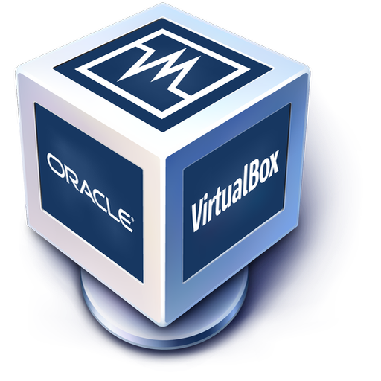

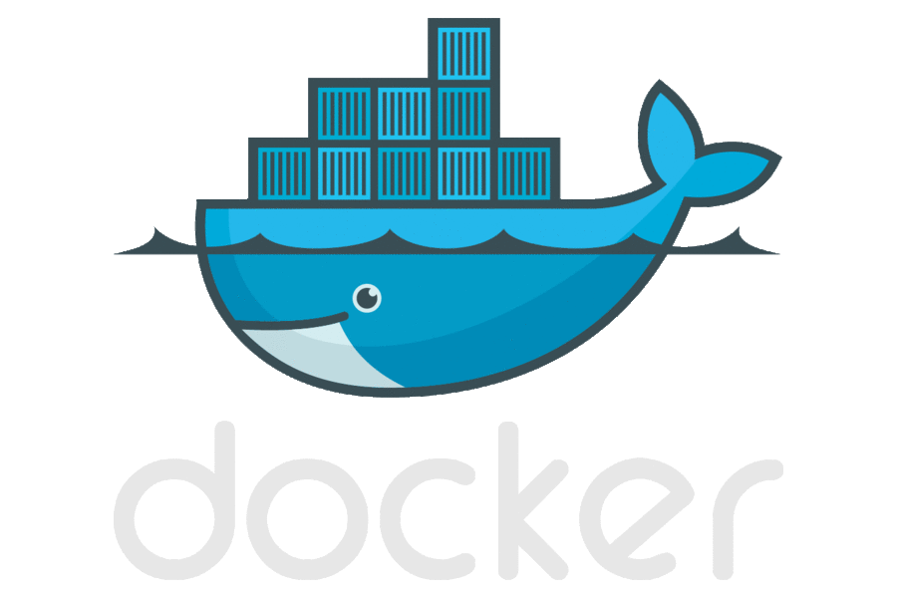


MongoDBaaS technology overview
PaaS / Configuration Management
Tools: Puppet, Chef, CFEngine, Cloud Foundry, OpenShift…
MongoDB (and other technologies) provisioning is ultimately driven by the chosen PaaS / configuration management tool
The PaaS calls into Ops Manager as needed (via REST API) for the provisioning of MongoDB
Infrastructure: IaaS, Virtual or Physical
MongoDB Provisioning
Ops Manager
Provisions MongoDB software on the underlying infrastructure / One click button
Ensures security compliance and deployment best practices
Provides monitoring and backup
VM hypervisor (Vmware, Vbox)
Cloud provider (Azure, Amazon)
Container manager (Docker, Drawbridge)
Pool of physical servers

Slide 64
target Architecture
MongoDBaaS for mutualized apps
(<2TB / Low-Medium Criticality)
Dedicated environment for critical
and/or large volume apps (>2TB)
Applications
MongoDB Driver
App#1
…
App#N
MongoDB Driver
MongoDB Driver
mongos
27017
mongos
27017
mongos
27017
mongos
27017
mongos
27017
mongos
27017
mongos
27017
MongoDB
Cluster
mongod
27018
mongod
27017
mongod
27018
mongod
27018
4 GB RAM
2cores
WT + 20 GB
4GB RAM
2cores
MMAPv1 + 100 GB
Tier 1
RS A
…
Tier 1
RS N
mongod
27018
mongod
27017
config
27019
mongod
27018
mongod
27017
mongod
27017
config
27019
8 GB RAM
2 cores
40 GB / 200 GB
mongod
27018
mongod
27018
mongod
27018
Tier 2
RS A
…
Tier 2
RS N
mongod
27018
mongod
27017
config
27019
mongod
27018
mongod
27017
16 GB RAM
4 cores
80 GB / 500 GB
mongod
27018
mongod
27017
Tier 3
RS A
mongod
27018
mongod
27018
…
Tier 3
RS N
mongod
27018
mongod
27017
mongod
27018
mongod
27017
32 GB RAM
4 cores
160 GB / 1 TB
Tier 4
RS A
…
Tier 4
RS N
64 GB RAM
8 cores
320 GB / 2 TB
Tier 5
RS A
…
Tier 5
RS N
Ops Manager: Automation, Monitoring & Backup

Slide 65
Sample Customer case key figures
x applications différentes
première
650 Go / an → Cible à 5 ans 4 To
seconde
300 Go / an → Cible à 5 ans 1,5 To besoin d’architecture dédie ( conformité , legacy )
Les autres sont beaucoup plus petites (Dans l’ordre de dizaines de Go)
Insert/Update
La plupart des données sont écrites en mode batch dans la nuit.
Lecture
Inconnu.
Autres infos
Backup à réaliser .
2 centres de données (1 serveur physique dans chaque DC)
4 serveurs virtuels

Slide 66
Target environment
2 shards each one with 3 nodes. WiredTiger as storage engine.
Each node having 6 x 2,5 Ghz cores and 256 GB RAM
1TB of independent storage for each mongod node.
SSD are highly preferred due to high IOPS.
15k disks are ok if RAID 1+0 is in place.
10k disks are acceptable if RAID 1+0 with 8+ HDDs is used.
Mongos processes (deploy as much as needed, typically one on each aplication server) require fewer resources:
1 x 2,5 Ghz cores, 4 GB RAM
3 config processes need to be deployed on different servers and require very few resources:
0,5 x 2,5 Ghz core, 2 GB RAM
MongoDB Driver
config
27019
mongos
27017
mongos
27017
config
27019
config
27019
mongod
27018
mongod
27018
mongod
27018
mongod
27018
mongod
27018
mongod
27018

Slide 67
Target environment
appli 2
1 replicaset with 3 nodes. WiredTiger as storage engine.
Each node having 4 x 2,5 Ghz cores and 128 GB RAM
750 TB of independent storage for each mongod node.
SSD are highly preferred due to high IOPS.
15k disks are ok if RAID 1+0 is in place.
10k disks are acceptable if RAID 1+0 with 8+ HDDs is used.
MongoDB Driver
mongos
27017
mongod
27018
mongod
27018
mongod
27018

Slide 68
Recommended environment
x
y
z
MongoDBaaS deployment on three physical servers.
3 shards each one with 3 nodes. WiredTiger as storage engine.
Each node on a virtual server having 2 x 2,5 Ghz cores and 8 GB RAM*
40 GB of independent storage for each mongod node.
SSD are highly preferred due to high IOPS.
Sharding not used. Each database runs in an independent shard.
Resource isolation
Simplified administration
Faster deployment of new databases
* RAM/CPU calculations could be different for each application, further details required.
Driver
Driver
Driver
config
27019
mongos
27017
mongos
27017
config
27019
config
27019
Physical
Server 1
mongod
27018
mongod
27018
mongod
27018
Physical
Server 2
mongod
27018
mongod
27018
mongod
27018
Physical
Server 3
mongod
27018
mongod
27018
mongod
27018

Slide 69
Final recommendations
Reserve resources
Databases are greedy processes. Use different servers to accommodate different processes.
If the previous is not possible, use some kind of partitioning or virtualization to avoid complete cannibalization.
Use the WT cache parameters accordingly to optimize the performance.
Ensure high availability using odd number of processes
Despite using 2 mongod + 1 arbiter is possible, this architecture is generally not acceptable
It doesn’t guarantee data persistency in all possible failure scenarios.
In case of 2 data centers deployments, 4 mongod + 1 arbiter is the recommended architecture
Place the arbiter in a different availability zone to obtain automatic failover in all scenarios.
Consider a MDaaS strategy for smaller applications that could benefice from common administration and security configurations
A centralized point to operate all MongoDB deployments with the added value of very efficient HW use.
Operate MongoDB deployments in your datacenter and in the Cloud from a single place: Ops Manager
Ops Manager automate maintenance tasks and ease server monitoring and diagnose.
Ops Manager could handle efficiently backups adding point in time recovery

Slide 70
Appendix – Comparison Charts vs. Key/Value, Relational

Slide 71
Data Model Comparison
 | MongoDB | Key/Value | Relational
Rich Data Model | Yes | No | No
Dynamic Schema | Yes | Yes | No
Typed Data | Yes | No | Yes
Data Locality | Yes | Yes | No
Field Updates | Yes | No | Yes
Easy for Programmers | Yes | Yes | No

Slide 72
Query Model Comparison
 | MongoDB | Key/Value | Relational
Key/Value | Yes | Yes | Yes
Secondary Indexes | Yes | No | Yes
Index Intersection | Yes | No | Yes
Range Queries | Yes | No | Yes
Geospatial | Yes | No | Yes
Text Search | Yes | No | Yes
Aggregation | Yes | No | Yes
MapReduce | Yes | Yes | No

Slide 73
Operational Capabilities Comparison
 | MongoDB | Key/Value | Relational
Automatic Failover | Yes | Limited | Yes
Data Center Awareness | Yes | No | Expensive Add-Ons
Continuous Backup | Yes | No | Yes
Point in Time Recovery | Yes | No | Yes
Caching Layer Needed | No | No | Often
Automatic Sharding | Yes | Yes | No

Slide 74
Appendix – GridFS

Slide 75
Store Larger Files
Store files larger than 16MB i.e. video, images
Load chunks without reading entire file into memory
Atomically sync files with their metadata
Shard and distribute around the cluster

Slide 76
Appendix – Hadoop and the larger Analytics Landscape

Slide 77



MongoDB & Hadoop
Applications
powered by
Analysis
powered by
MongoDB Connector for Hadoop
Notes:
MongoDB
Low latency
Rich fast querying
Flexible indexing
Ad hoc aggregations in database
Known data relationships
Great at looking at any subset of data
Hadoop
Longer jobs and queries
Analytical processing
Often highly partitionable
Unknown data relationships
Great at looking at all of data

Slide 78








MongoDB in the Analytics Landscape
Batch / Predictive / Ad Hoc
(mins – hours)
Planned Reporting
(secs – mins )
Real-Time Dashboards / Scoring (<30 ms)
Experimental
Legacy

Slide 79
Analytics Landscape
Response | Data Supported | Maturity | Analytical Capabilities | Ease of Use
Real-Time | ● | ◑ | ◑ | ◕
Batch | ● | ◑ | ◕ | ○
Batch | ◑ | ◑ | ◔ | ◑
Interactive | ◑ | ◔ | ◔ | ◑
Interactive | ● | ○ | ◑ | ○
Interactive | ◔ | ● | ● | ●

